Slide 1
L4_1 Morris Screening for sensitivity analysis
Gürkan Sin, Associate Professor
PROSYS- DTU Chemical Engineering

Slide 2
Agenda
9:00-12:00 | L4.1 Morris Screening
 | Exercises
Lunch break
1:00-4:00 | Catch up with exercises
 | Free time with instructors

Slide 3
Objective of this lecture
At the end of the lecture, you should be able to:
Perform sensitivity analysis using Morris Screening on a simple model
Apply the method and Interpret the results on a slightly complex model

Slide 4
Outline
On sensitivity analysis (recall)
Morris method
Elementary effects (EE)
Morris sampling
Case study: Morris method in batch fermentation models
Example: Oxygen Uptake Rate (OUR)
Exercise: Simple fermentation model

Slide 5
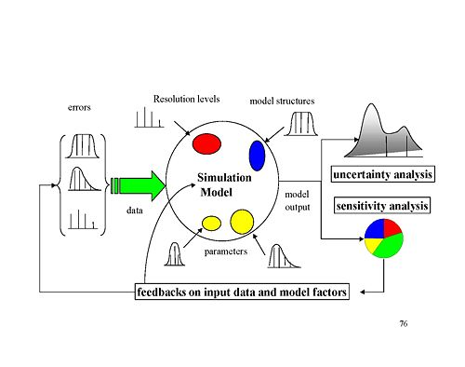
Sensitivity analysis – a definition
Sensitivity analysis ”studies how variation (uncertainty) in the outputs of a model can be apportioned to different sources in the input of a model”
SA complimentary to uncertainty analysis: ”quantifying uncertainty in the outputs of a model from uncertainty in its inputs ”
inputs
model
outputs
Saltelli et al., 2008

Slide 6
Sensitivity analysis – practices
SA may be used for a number of purposes:
Identify critical region in the input space of a model
Establish research priorities (by knowing to which inputs the model response is the most sensitive)
Debugging model coding errors (detecting a non-important parameter as important)
Simplify models / test hypothesis
...

Slide 7
Sensitivity analysis – Putting Morris method in context
A number of methods available each with its own advantages/drawbacks
Local methods
Derivative based, One-factor-at-A-Time (OAT), ...
Local measure: small perturbation around base value
Hence the analysis is locally bounding, not extrapolative!
Global methods
Regression, variance-based, ...
May be computationally demanding
Morris method (1991):
Combines advantages of the two: Performs local sensitivity calculations in a global context (thanks to special sampling method)

Slide 8
Morris method (Morris, 1991) – Elementary effects (EE)
Let us take a model of the form:
The elementary effect of the i^{th} input factor, θ_{i}, in a point θ⁰ (input space):
θ₂
Note: it is hard to visualize m-dimensional input space.
Take a 2-D input space as an example!
θ₁

Slide 9
Morris method (Morris, 1991) Concept of elementary effects (EE)
Each input assumed to vary across p levels (discretized approach):
For θ_{i} ~U(0,1) & p = 4 → p₁ = 0, p₂=1/3, p₃=2/3 and p₄ = 1
Optimal choice of perturbation coefficient, Δ, depends on the levels:
Δ = p / 2(p-1) (E.g. for p = 4, Δ = 2/3)

Slide 10
Morris method (Morris, 1991) -am Concept of elementary effects (EE)
The choice of perturbation factor: Δ is optimal when Δ = p / 2(p-1)
Uniform sampling of input
Not-uniform sampling of input
Histogram
θ
θ

Slide 11
The Morris sampling
EEi is still a local measure, so?
Solution: take the average of several EEi !
Morris suggests calculations of EEi at randomly selected points in the input space (m-dimensional p-level grid) and to approximate the distribution of elementary effects, Fi.
To this end, Morris performs EEi calculations r times following an efficient randomized sampling scheme (see Morris Sampling, 1991).
r is chosen in the range of 5-10.
θ₂
θ₁

Slide 12
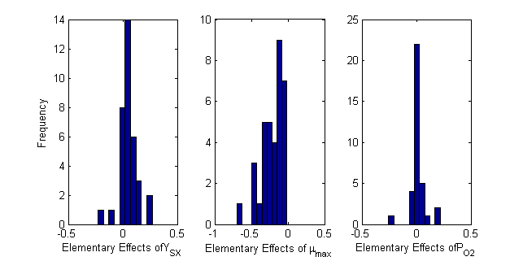
Interpretation of Morris method
The distribution of elementary effects of model inputs on the model outputs,
Fi: 35 random observation of EEi
Analyse & compare the mean and standard deviation of these distributions.
Higher mean and higher standard deviation of FEEi indicates strong sensitivity!

Slide 13
The Morris sampling
Low computational cost: Morris requires only r*(k+1) model evaluations
Example:
For k = 10 parameters, Fractional factorial design at 2 levels→ 2¹⁰ = 1024
Morris sampling = 10*(10+1) = 110
For k = 20 parameters, FF design at 2 levels → 2²⁰ = 1048576
Morris sampling → 10*(20+1) = 210

Slide 14
Morris method – the extended
To enable comparison of the elementary effects on different model outputs, y_{j}, a relative measure of elementary effects is needed (where j >2)
A possible relative measure is obtained by sigma-scaling:

Slide 15
S. coelicolor cultivation for antibiotic production
Case study: Application of Morris method to fermentation models

Slide 16
Morris method: methodology
Morris sampling for EEi
Step 1. Specify range for each input parameter
Step 2. Morris Sampling
Step 3. Model evaluations of Morris samples
Step 4. Compute and plot elementary effects (EEi)
Step 5. Rank parameters according to μi & σi (Morris) or absolute μi∗ (Saltelli)

Slide 17
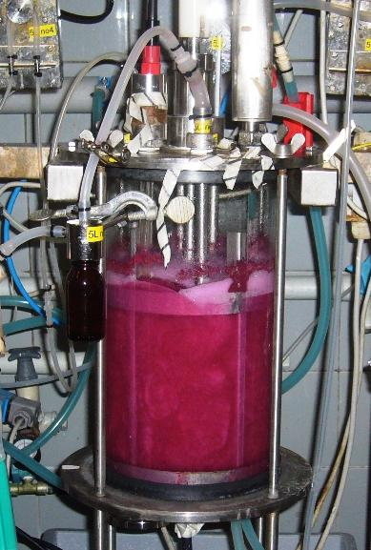
Case study: Batch cultivation of S. coelicolor for antibiotic production
measurements:
Biomass, glucose, NH₄⁺
Glucose, air, base
On-line measurement:
CO₂, dissolved O₂, temperature, pH, Base addition, etc.
Notes:
17
What we try is to replace off-line measurements of relevant variables with on-line measurements using NIR. On-line prediction of biomass and glucose could then be used within for example feed-back control to improve reactor operation (e.g. addition of substrate can be controlled in a fed-batch fermentation)
The graph shows a comparison between off-line substrate measurements (dots) and on-line (predictions) based on NIR. It illustrates that we can predict glucose quite well, which opens up for establishment of control strategies

Slide 18
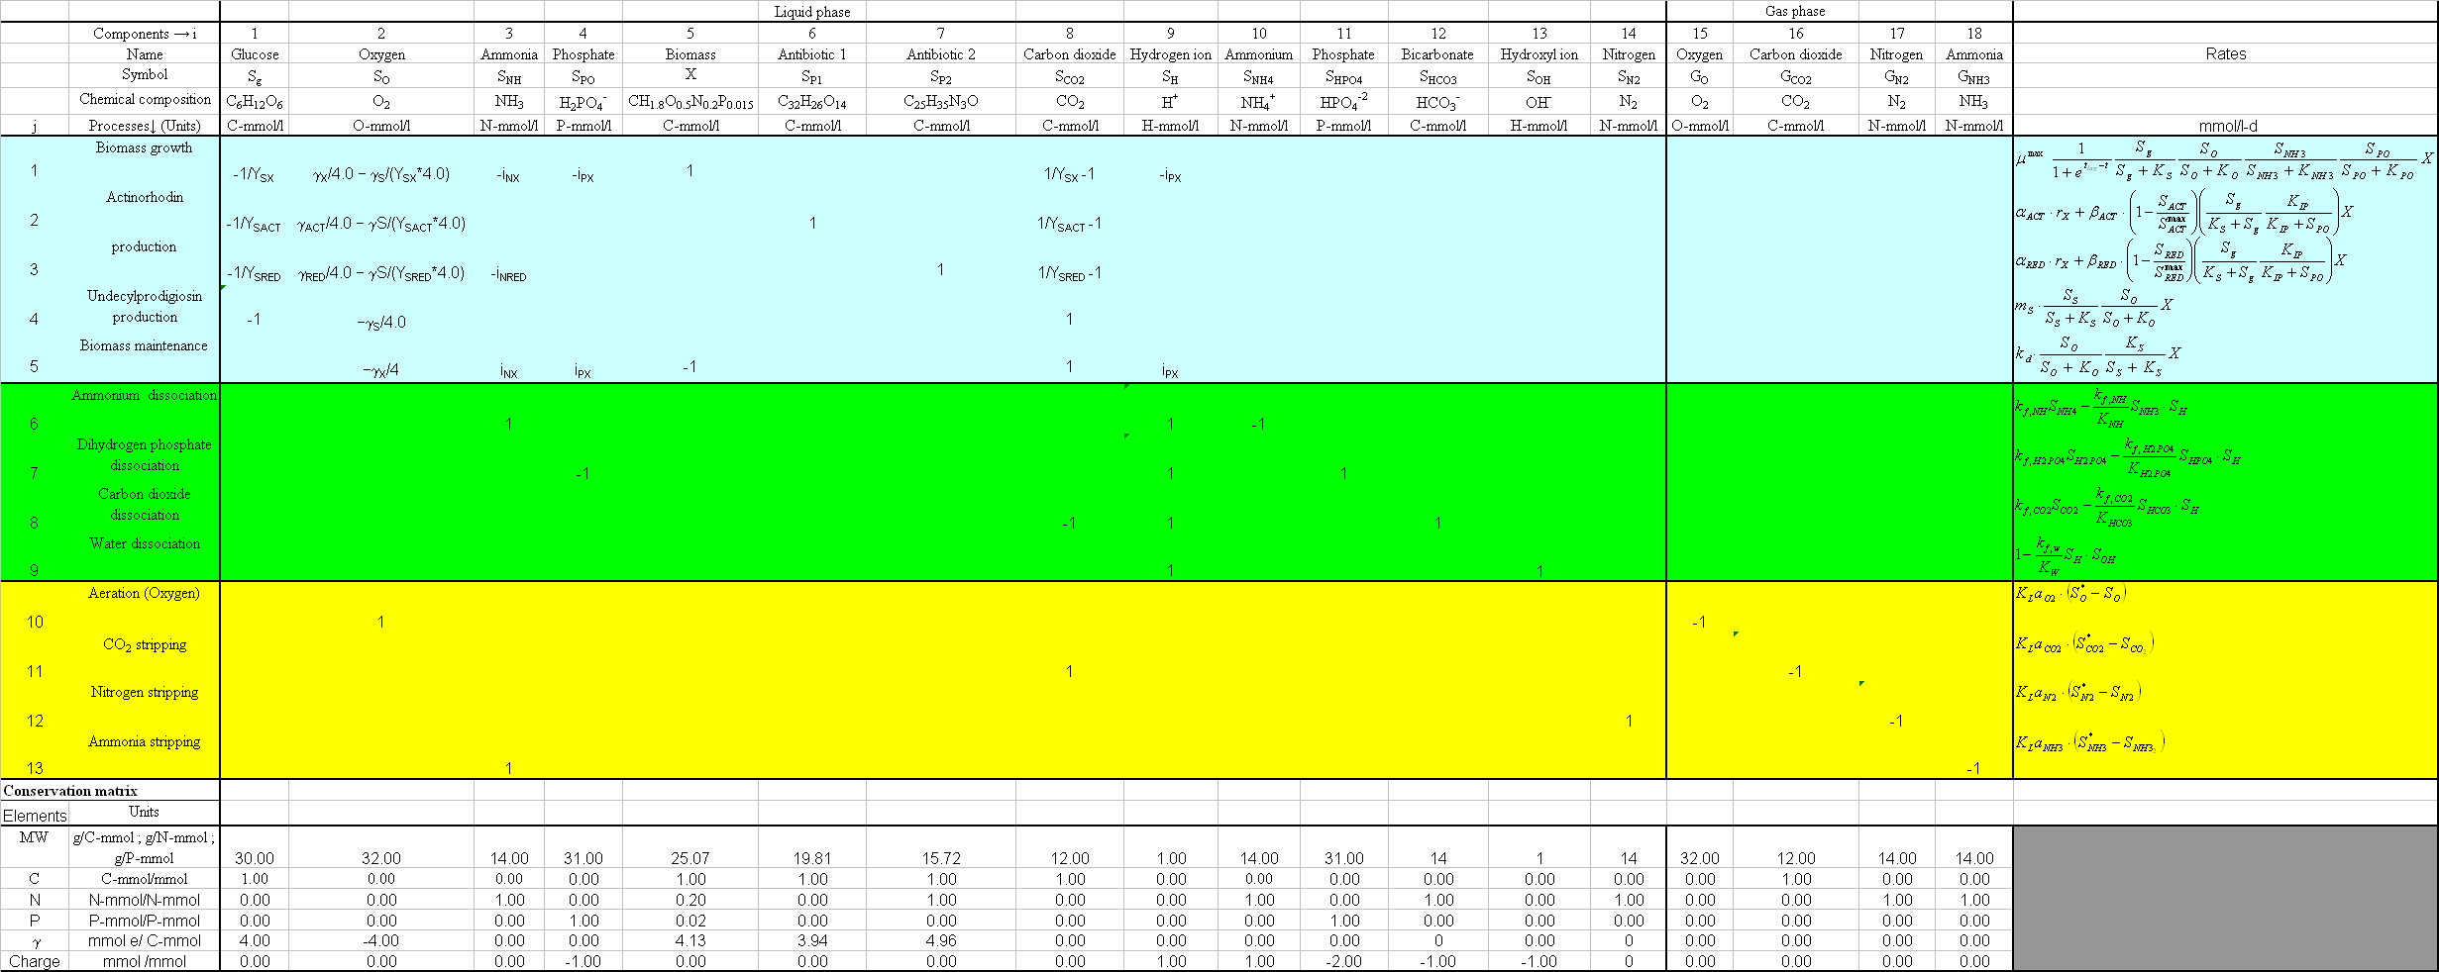
Matrix, model of S. coelicolor fermentation
Equations biological processes
Equations chemical equilibria
Equations mass transfer
Conservative properties
Sin et al. (2008). Biotechnol. Bioeng., 101:153-171
Many outputs (around 20)
Many parameters (around 60)

Slide 19
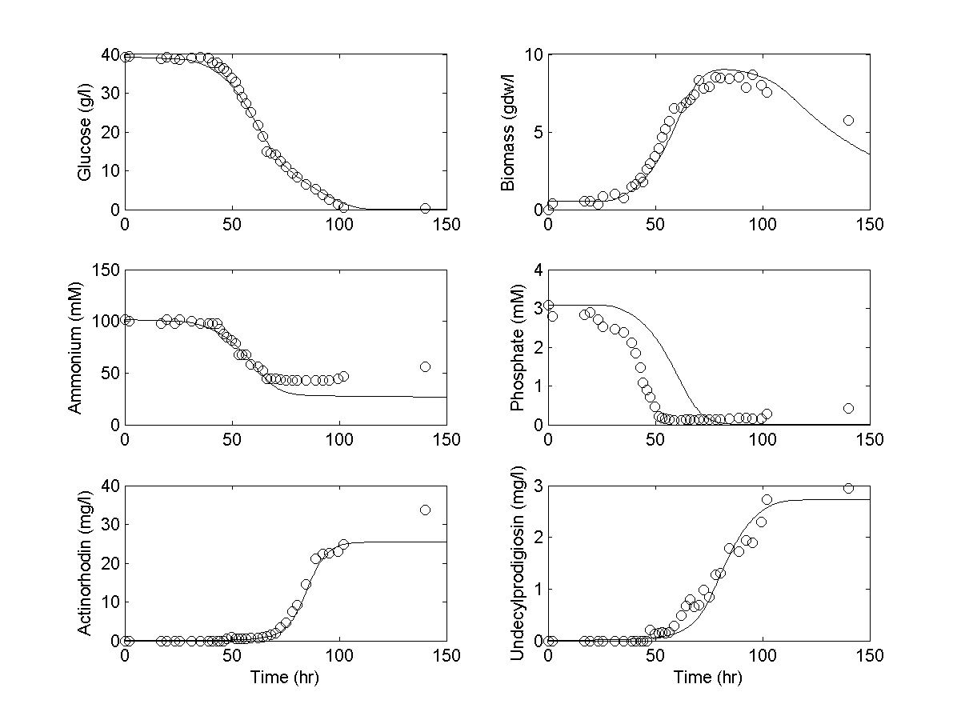
Model fits to measurements
Sin et al. (2008), Biotechnol. Bioeng., 101:153-171
Notes:
Sin et al (Biotechnol. Bioeng) developed a first-principles model for the fermentation with Streptomyces coelicolor.
The graphs show that there is a good model fit, i.e. we seem to have a pretty good description of the dynamics of the fermentation.
Phosphate is the exception, no good model fit. This indicates that there is some mechanism that is not included in the model we made. Checking in the literature learned us that S. coelicolor probably can store phosphate internally in the cells, meaning that concentrations decrease more rapidly in the experiment compared to the model (no P storage included in the model). If we would now include that mechanism (P storage) in the model, we could improve the model fit (and our understanding about the process).
Applying uncertainty analysis (spaghetti plots) to the first-principles model followed by sensitivity analysis (shows which inputs have most influence on the outputs) can be helpful in directing experimental work: if an input has large influence on the output, then it is worth to spend time to measure that input. If an input has no large influence on the output, then it is not worth to spend time and energy on trying to measure it.

Slide 20
Morris method – sampling specifications
Morris method specifications:
p = 4 , Δ = 2/3, r = 35, k = 60 (# number of parameters)
Total model evaluations = r*(k+1) = 2135
Morris sampling of 3 model parameters

Slide 21
Results – Typical outcome of Morris method
The distribution of elementary effects of model inputs on the model outputs,
Fi: 35 random observation of EEi
Model output: glucose
model inputs: Ysx, μ^{max} and P_{o2}
Analyse & compare the mean and standard deviation of these distributions

Slide 22
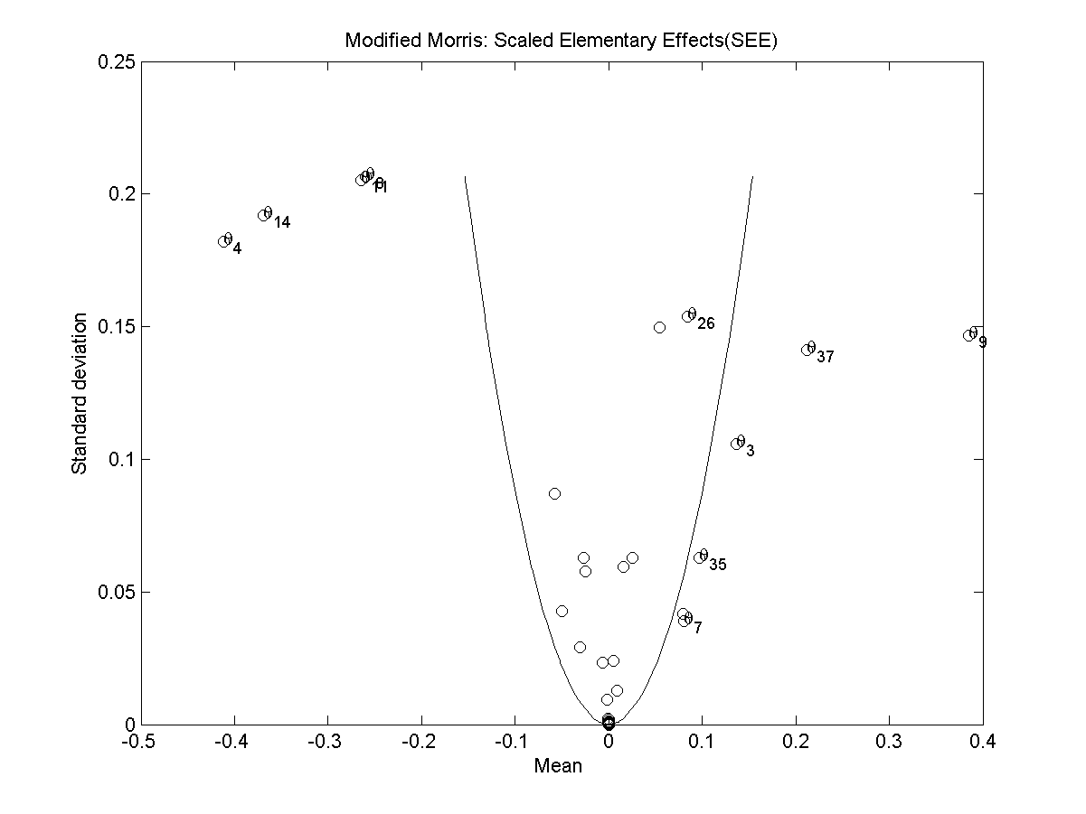
Results – typical results of Morris method
Example: Glucose as model output versus a total of 56 input factors
Conclusion: 8 influential factors, the rest of the factors have insignificant contribution to the variation in glucose
Non-influential factors
influential factors
influential factors
Notes:
Accordingly, if an input parameter (i.e. a circle) lies inside the wedge, then it indicates that its effect on the output is negligible and can be deemed insignificant. On the contrary, if the input parameter lies outside the wedge, then it is said to have a significant effect on the output. We also observe that these significant parameters are involved in non-linear interactions as their standard deviations (see the y-axis in the subplots) are non-zero¹⁰.

Slide 23
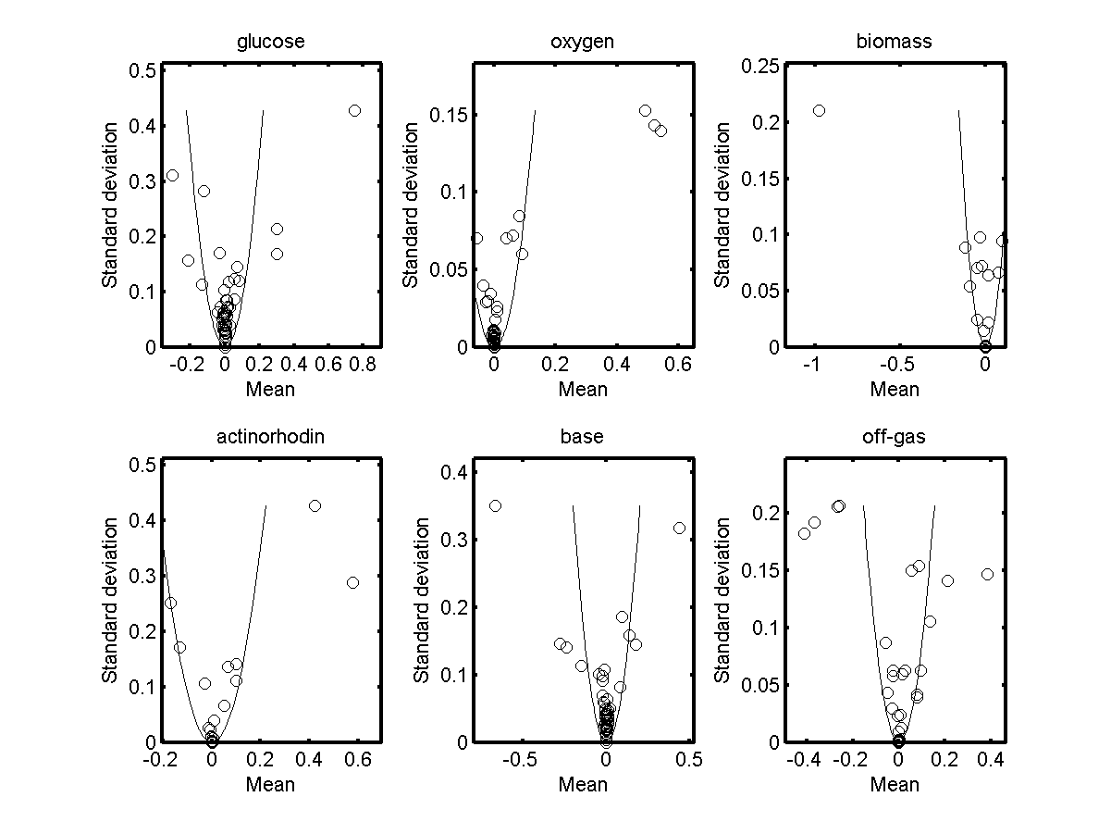
Elementary effects of different model outputs
Each point represents the effect of an input on respective outputs
Now one can zoom in and study in detail which input affects which output!

Slide 24
Comparison of extended Morris with Monte Carlo based regression method (SRC)
Table. Method comparison for screening influential factors:
Model output glucose
 | Morris Method |  | Monte-Carlo based regression
Rank | Input symbol | μ* | Input symbol | SRC*
1 | i_{PX} | 0.75 | K_{P} | 0.74
2 | m_{S} | -0.30 | μ_{max} | -0.65
3 | K_{P} | 0.30 | i_{PX} | 0.61
4 | K_{S} | 0.30 | K_{S} | 0.50
5 | μ_{max} | -0.21 | m_{S} | -0.47
6 | pK_{H2PO4} | -0.13 | t_{lag} | 0.18
7 | i_{NX} | -0.12 | pK_{H2PO4} | -0.16
8 | pK_{NH} | 0.08 | K_{HO2} | 0.06
Bottom line: Morris method agreed mostly (6/8) with the well established regression based method

Slide 25
EXAMPLE: AEROBIC GROWTH OF microorganismS
Morris method for sensitivity analysis

Slide 26
Morris method: methodology
Monte Carlo simulations + linear regression for sensitivity analysis
Step 1. Specify range for each input parameter
Step 2. Morris Sampling
Step 3. Model evaluations of Morris samples
Step 4. Compute and plot elementary effects (EEi)
Step 5. Rank parameters according to μi & σi (Morris) or absolute μi∗ (Saltelli)

Slide 27
step 1 to 2: Morris sampling results
Matlab code (Morrissampling.m)
ourinit
pmor=par(1:4); % get the reference parameter values /we assume we dont have any data for PE. otherwise we dont use Monte Carlo
lp = {'Y_{SX}','\mu_{max}','K_S','k_d'};
inputunc=[0.05 0.10 0.25 0.25]; % expert input uncertainty indicates degree of uncertainty [0: Low , 1: High]
k=length(pmor); % number of parameters
xl= pmor .* (ones(1,k)-inputunc);
xu= pmor .* (ones(1,k)+inputunc);
%% Morris sampling parameters
k = k ; % no of parameters or factors
p = 4 ; % number of levels {4,6,8}
dt = p/(2*(p-1)) ; % perturbation factor .
r = 15; % number of repetion for calculating the EEi, e.g. 4 - 15
%% Morris sampling will produce discrete uniform probabilities for each
%% factor.
X = morris(p,dt,k,r);
Xmean = mean(X) ;

Slide 28
step 1 to 2: Morris sampling results
k=4 (parameters), p = 4 (levels), r = 15 (repetition), Δ=2/3, n= 75 (r*(k+1)

Slide 29
step 1 to 2: Morris sampling results
m=4 (parameters), p = 4 (levels), r = 15 (repetition), Δ=2/3, n = 75 (15*4+1) (# simulations)

Slide 30
step 3: Model evaluations of Morris samples (raw data)
Matlab code (morrissim.m)
% load sampling matrix
load MorrisSampling_r15_p4
[n m] = size(Xval) ;
% specify time (in hr) % initialize:
time = [0:(1/50):0.5];
ourinit
% run Morris simulations
for i=1:n
% update the uncertain parameters
par(1:4)=Xval(i,:);
%% Solution of the model
options=odeset('RelTol',1e-7,'AbsTol',1e-8);
[t,y] = ode45(@ourmod,time,x0,options,par);
%% calculate oyxgen uptake rate (O-mmol/l-min)
y1(:,i) = y(:,1);
y2(:,i) = y(:,2);
y3(:,i) = y(:,3);
end

Slide 31
step 3: Model evaluations of Morris samples (raw data)
Total number of simulations, n = 75 (=15*(4+1))

Slide 32
step 4: Compute elementary effects
Matlab code: computeEEi.m
load MorrisSims_r15_p4.mat
%% this method requires scalar outputs, y:
% hence one needs to specify a meaningful property of time-series data: Let us focus on time=0.3 hr
ii = find(time == 0.3) ;
y1s = y1(ii,:); y2s = y2(ii,:); y3s = y3(ii,:); ours = our(ii,:);
%% compile an model output matrix
Sim = [y1s' y2s' y3s' ours'];[n k] = size(X) ; n = n / (k+1);
[mm ll] = size(Sim) ;
%% below info needed for sigma-scaling of EEi
sig_y = std(Sim);
sig_x = std(Xval);
%% compute the corresponding Eei
for i=1:n
for j=1:k
m1 = (k+1)*(i-1);
r1 = m1 + j ;
ix = find (X(r1,:) - X(r1+1,:)) ; % find the non-zero value
if length(ix) > 1
warning('there is more than one factor changed')
return
end

Slide 33
step 4: Compute elementary effects
y: Substrate
sy= y(t=0.3h)

Slide 34
step 4: Compute elementary effects
y: oxygen
sy= y(t=0.3h)

Slide 35
step 4: Compute elementary effects
Y: biomass
sy= y(t=0.3h)

Slide 36
step 4: Compute elementary effects
y: our
sy= y(t=0.3h)

Slide 37
step 5: Rank parameter significance
Morris: consider standard error on the mean of EEi(sem). Use this to form a wedge! Parameters inside the wedge insignificant, outside significant. (plotmorrissim.m)
Positive:
Visually appealing!
consider the quality of estimating mean Eei
Combines info of mean and sigma of Eei
Negative
Becomes cumbersome for models with many parameters!
1

Slide 38
step 5: Rank parameter significance
Saltelli: Focus on the absolute measure of the mean of EEi and rank them!
 | Substrate | Rank* | Oxygen | Rank | Biomass | Rank | OUR | Rank
Y_{SX} | 0.50 | 2 | 0.15 | 3 | 0.31 | 3 | 0.43 | 2
μ_{max} | -0.89 | 1 | 0.90 | 1 | 0.81 | 1 | -0.99 | 1
K_{S} | 0.23 | 3 | 0.00 | 4 | -0.21 | 4 | 0.26 | 3
k_{d} | 0.00 | 4 | -0.30 | 2 | -0.49 | 2 | 0.00 | 4
Positive:
Helps ranking parameter importance with single measure!
Drawback:
Ignores information in standard deviation

Slide 39
Quality check: compare the results of Morris with SRC or other SA methods
sy= y(t=0.3h)
 | substrate |  | oxygen |  | biomass |  | our
 | Morris, μ_{i} | SRC | Morris, μ_{i} | SRC | Morris, μ_{i} | SRC | Morris, μ_{i} | SRC
Y_{SX} | 0.50 | 0.38 | 0.15 | -0.14 | 0.31 | 0.47 | 0.43 | 0.36
μ_{max} | -0.89 | -0.85 | 0.90 | 0.85 | 0.81 | 0.79 | -0.99 | -0.89
K_{S} | 0.23 | 0.22 | 0.00 | -0.03 | -0.21 | -0.21 | 0.26 | 0.16
k_{d} | 0.00 | 0.01 | -0.30 | -0.09 | -0.49 | -0.20 | 0.00 | 0.04
Bottom line: The results of Morris and SRC agree well with each other with one exception (Ysx on Oxygen)! Empirical evidence that senstivity analysis results are reliable!

Slide 40
To sum up
Morris method allows screening of the importance of model parameters (inputs) on the outputs
It is robust wrt type II error (identifying a non-important parameter as important)
The original method considers one type of model output. The extended method is applicable to a model with many outputs (thanks to sigma-scaling of EEi)
Recommended as efficient screening method prior to more detailed and computationally exhaustive methods, such as Sobol’s variance decomposition.

Slide 41
Aerobic growth of microorganism
Exercise 1: Repeat Morris method of sensitivity analysis

Slide 42
Exercise details
Do the exercise individually
Use the matlab scripts introduced earlier using the OUR example
Follow the steps outlined above in the example (slide # 23)
and learn by doing! For example to learn Morris sampling theory in detail, first read the accompanying paper and then check the morris code. you may do the following:
Open the morrissampling.m
Set r equal to 1. investigate the resulting samples (X and Xval)
Set r equal to 2. investigate the resulting samples (X and Xval)
In the same manner, change the p parameter to 6 and repeat above steps.
Write down the results on a paper and compare them with the theory of morris sampling (see the paper).

Slide 43
Simple fermentation model
Exercise 1: Repeat Morris method of sensitivity analysis

Slide 44
Exercise details
Do the exercise individually
Use the matlab scripts introduced earlier using the OUR example, BUT this time use the fermentation model!
Adopt the scripts if necessary for your exercise!
Follow the steps outlined above in the example (slide # 23)
and learn by doing!
We will be around to help you out!....

